Slide 1
You too can DevOps
How to integrate CI/CD in traditional domains
Notes:
“Etsy deploys 50 times a day”. “High Performers deploy 30x more” – State of DevOps

Slide 2

$ whoami
A geek that likes working with computers (shocking, I know)
Full-stack dev with experience in Python, .NET, Angular, Linux, etc.
Published papers on TDD and DevSecOps
Implemented CI/CD for the High-frequency trading space and did consulting for Banking Service Provider

Slide 3

What is DevOps?
Notes:
Standard definition of. DevOps. It’s about Faster releases and Collaboration
How you do DevOps depends on you. You can have a DevOps team, or you have Dev+Ops = One team or you have DevOps engineers, it depends.

Slide 4

It’s a way of doing things
This means that technology is only part of the equation
There are aspects of culture, automation, sharing and measurement with DevOps

Slide 5
But I can’t because…
The Client owns the environment totally and won’t give us access at all, so no automated releases.
I don’t have the time and resources to make such a shift and I don’t see the value.
I don’t think I need it. My process is fine as it is.
My process needs manual reviews that cannot be automated under any circumstances.

Slide 6
So let’s take it slow…
Create a build…
Create releases…
Publish release artifacts…
Rinse, repeat

Slide 7
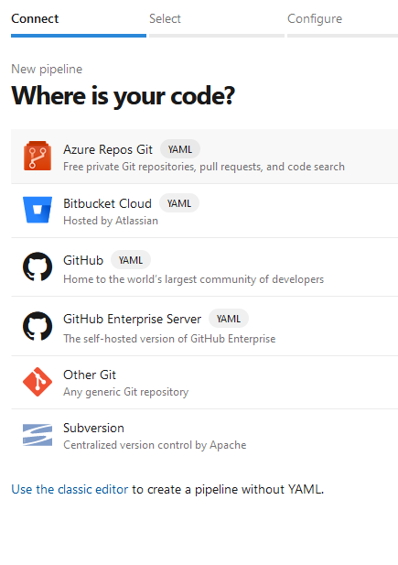
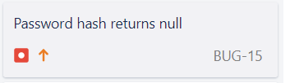
The Build Pipeline
Take your code from anywhere
This code could also be connected to some Jira board or other such solution

Slide 8
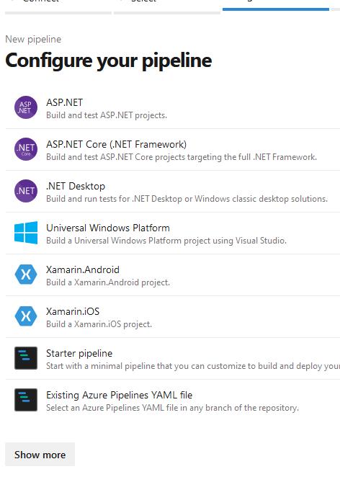
The Build Pipeline
Select a template or start with an empty pipeline.

Slide 9
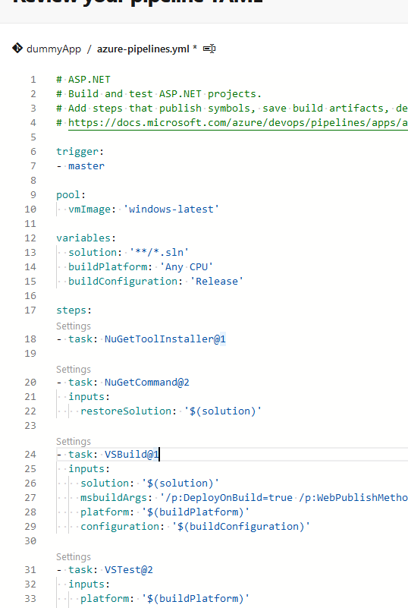
The Build Pipeline
Work with the YAML

Slide 10
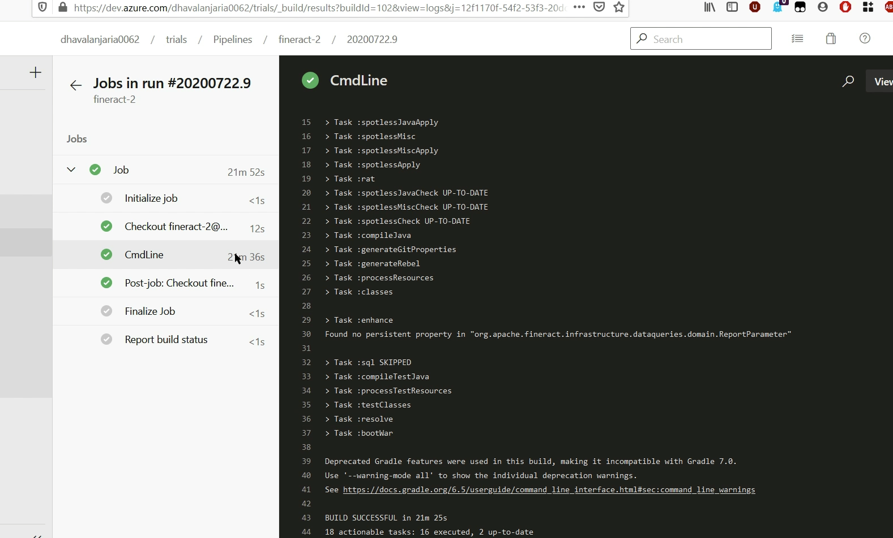
See the build output
Notes:
“What did we do, Thursday, two months ago?”

Slide 11
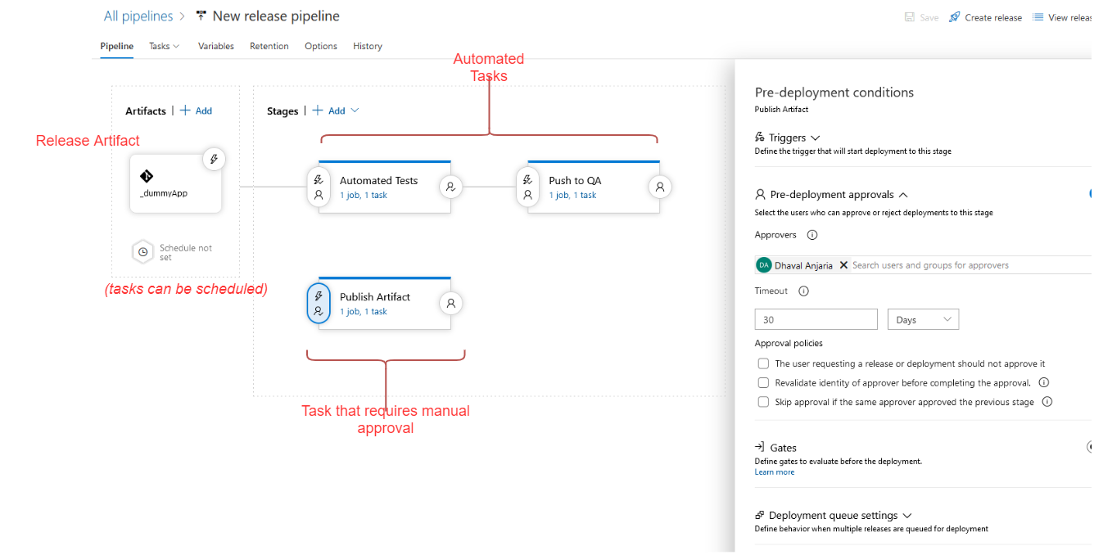
Release Pipelines

Slide 12
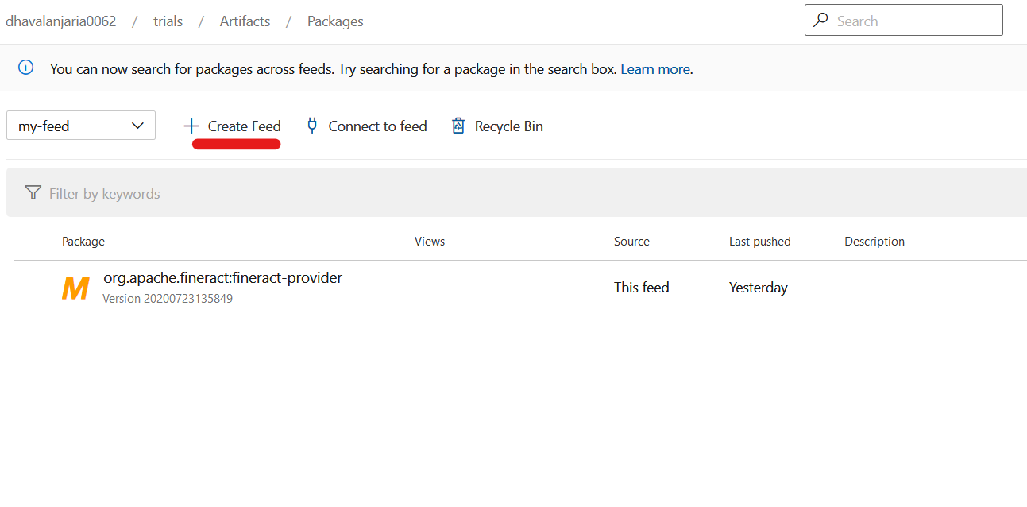
Make them available

Slide 13
Brave New World

Slide 14
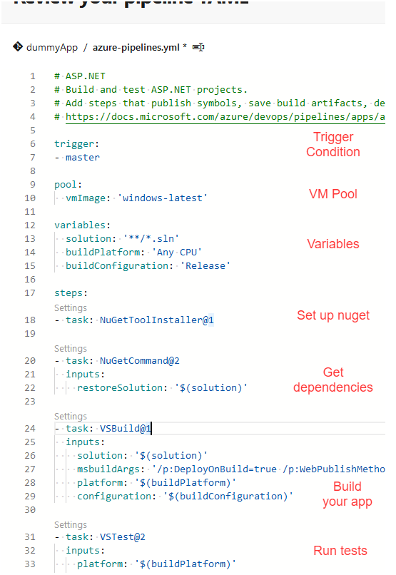
There will be complexity
This is still not going to be easy
CI/CD pipelines add complexity
Notes:
Mention: Build times can be quite significant. The automation scripts and IaC will be additional complexity that you will have to deal with. However, the payoff is considerable.

Slide 15
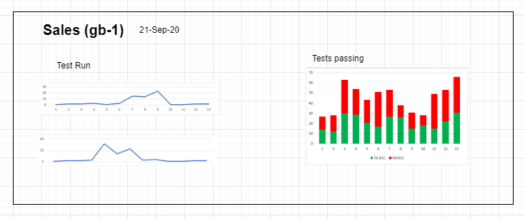
But there will also be visibility
Everyone can see when and where things go wrong.
Therefore, everyone’s incentives will be better aligned, because everyone will know what’s wrong.
Show, don’t tell – Bring people together with monitoring
Notes:
Monitoring unites people if monitoring data is made visible to everyone.
For example, we had a bunch of people use Discord for the first time. The mod introduced the idea of bots and then suddenly, everyone started playing around with the bot. These people were absolutely not IT people but because they saw what needed to be done, they learned how to write bot commands. Not the best example, but it the point is, make it VISCERAL.

Slide 16
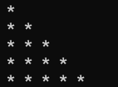
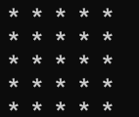
Feedback is super-valuable
When I was starting out, I didn’t use a debugger or logging, I just ran the program.
I do console.log(“HERE!!!!!”); because I want feedback
Expected Output
My output

Slide 17
Automate all the things… or not
You don’t have to have end-to-end automation.
Manual tasks like security and compliance checks, reviews can be done in parallel.
It can still relax your critical path.

Slide 18
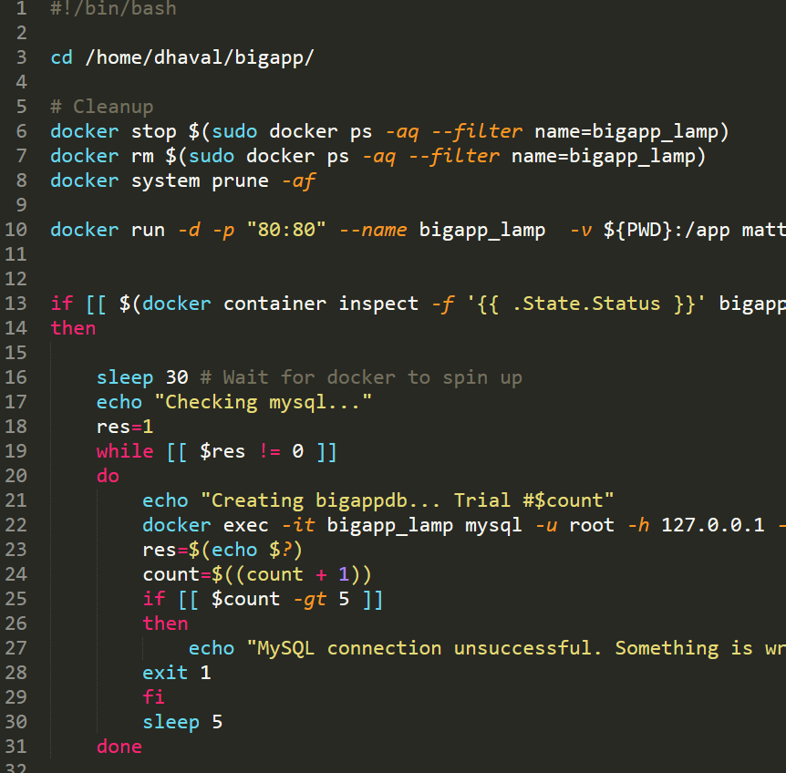
run_task.sh
“I could write a script for this…”
And scale it to the entire dev process

Slide 19

Automation is still worth doing
Improve traceability for compliance purposes (and just get more visibility).
Get some testing done.
If you automate security, then it will contribute to your faster release cycle.
Notes:
Mention how standardization also would lead to easier onboarding. Because they don’t have to remember a bunch of manual steps.
And that standardization makes stuff less error prone (which is just an advantage of automation).
Primarily, automation means fewer errors because fewer manual steps. You don’t have to depend on the *discipline of the other guy.*

Slide 20

Commoditize your infra
Standardize makes things easier for ops
Standardize to reduce your security exposure
Notes:
This perhaps is the BIGGEST ADVANTAGE

Slide 21
Technology is made of people
Talk about your issues over lunch or coffee
Fix problems faster, or prevent them altogether by working together.
Solutions can come from a number of places. Trust your people to have good insights.
Notes:
“I should talk to ops about this”
Talk about the foreign key incident, perhaps?
Once you have embraced this…

Slide 22
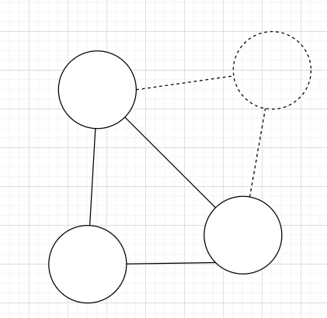
Happy side-effects
Changes are being added faster, so your app needs to be resilient to change.
Conway’s law works in your favor.
Notes:
Having CI/CD and have more changes works to make your code more modular.
Conway’s law works because although it might seem that this would lead to tight coupling, what ends up happening is that you have independent modules with heavy communication between them. That’s why DevOps works for Microservices.
Feature flags help you turn off features that might be causing issues in production.

Slide 23

And now the flipside
This is a complex migration, one that will increase work for developers.
You’ll never have full automation and for security, compliance and host of reasons, there are still manual processes.
CI/CD is complex. More complex pipelines can be harder to troubleshoot.
Build times will matter a lot.
There are security concerns with increased collaboration.
Specialized skills and cross-training is required.

Slide 24
In the long run however…
Respond to the market faster.
Automation will make your teams more productive.
Faster releases mean faster feedback, which mean faster fixes.
CI/CD can lead to “safer” releases.
Monitoring is important because software systems are complex.
Embracing CI/CD has a lot of positive side effects, like working better together.
Remote work is not a hinderance, but an enabler.

Slide 25
See also…
“The Phoenix Project”, by Gene Kim.
Google’s SRE course on Coursera.
“A qualitative study of DevOps usage in practice”, F.M.A Erich, C. Amrti, M. Daneva
“DevOpsSec”, Jim Bird
“Trade-Ofs in Continuous Integration: Assurance, Security, and Flexibility”, Michael Hilton, Nicholas Nelson and Timothy Tunnel
“The DevSecOps and Agency Theory”, Jong Seok Lee
“Containers will not fix your broken culture (and other hard truths)”, Bridget Kromhout

Slide 26

Get in touch with me
Phone: +91 988 1585 223
Email: dhv2712@gmail.com | dhaval.anjaria@associates.scit.edu
LinkedIN: https://www.linkedin.com/in/dhavalanjaria/
Twitter: @DhavalAnjaria

Slide 27
Thank you
Questions, please?

